Slide 1
The Universe is Mine! Building apps that run on all Windows 8.1+ devices
David Underhill
Software Developer
TechSmith Corp
Presentation is on Github: https://github.com/underhilld2/OneDevDayDetroit2014
Email: underhilld2@gmail.com
Twitter: @DavidUnderhill3
https://github.com/underhilld2
http://blog.davescybercave.com

Slide 2
Agenda
About me
What is a Universal App and how to get started
API Documentation
Tools that can help
Anatomy of a Universal App
Platform Specific Code
Shared Code
Implementing Portable Class Libraries

Slide 3
About Me
Developer for TechSmith Corp
Almost 20 year of professional experience
Most recent projects on Windows Phone and Store 8.1
Previous experience in everything from GW Basic to Cobol to C to Java on PC, Unix, and Mainframe.

Slide 4
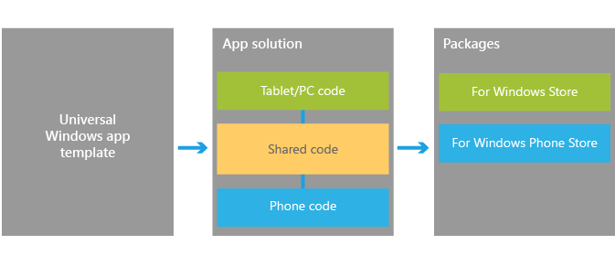
What is a Universal App
Notes:
Windows 10 convergence
This excites me the most about the coming years. I think MS kind of got lost when the released Vista and it flopped hard. Windows 7 and 8 were both steps getting us to 8.1. I really feel 8.1 is the major milestone to getting them back on track.
Currently Store and phone are supported and the roadmaps that have been talked about say that Xbox will also be in the list of packages you can create.
Develop once for all Windows devices using a unified Windows runtime and VS tools that allow you to both support experiences unique to a device in XAML, HTML, and DirectX, and share the code that supports those experiences across all devices using C++, C#, or JavaScript. When your work is finished you can you can produce the app packages that you will submit to the Windows Store and Windows Phone Store with a single action to get your app out to customers on any Windows device.
In terms of the Store experience, customers will benefit from an app identity shared across the Windows Store and the Windows Phone Store. Shared identity means that if they purchase your app from the Windows Store, they are capable of installing it on a device from the Windows Phone Store using the same Microsoft account without having to purchase the app again. Optionally, this can also include things like in-app purchases.
To get you started, the following sections will identify key upgrade paths, migration paths, and other critical resources that will help you bring your ideas to the converged Windows 8.1 platform. For more information on universal Windows apps and context on Microsoft’s vision for developer opportunity on Windows devices, please see our blog post Introducing universal Windows apps.

Slide 5
How to get setup to do store and phone development
https://dev.windows.com/en-us
https://devcenterbenefits.windows.com/
Notes:
https://dev.windows.com/en-us
https://devcenterbenefits.windows.com/

Slide 6
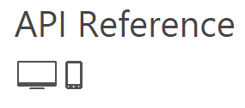
API Documentation
Minimum supported client | Windows 8 [Windows Store apps, desktop apps]
Minimum supported server | Windows Server 2012 [Windows Store apps, desktop apps]
Minimum supported phone | Windows Phone 8.1 [Windows Phone Silverlight 8.1 and Windows Runtime apps]
Namespace | Windows.Media.CaptureWindows::Media::Capture [C++]
Metadata | Windows.winmd
Capabilities | webcammicrophone
Notes:
Demo here show msdn page
Where are we with feature parity
What I have found is that we are really close on feature parity between universals 8.1 store and phone and then Silverlight 8.1 apps but not completely there.
http://msdn.microsoft.com/library/
http://msdn.microsoft.com/en-us/library/windows/apps/xaml/windows.media.capture.mediacapture.aspx
http://msdn.microsoft.com/en-us/library/windows.phone.media.capture.aspx
http://msdn.microsoft.com/en-us/library/windows/apps/xaml/windows.applicationmodel.package.aspx
Where are we with feature parity
What I have found is that we are really close on feature parity between universals 8.1 store and phone and then Silverlight 8.1 apps but not completely there.
http://msdn.microsoft.com/library/
http://msdn.microsoft.com/en-us/library/windows.phone.media.capture.aspx
http://msdn.microsoft.com/en-us/library/windows/apps/xaml/windows.applicationmodel.package.aspx

Slide 7
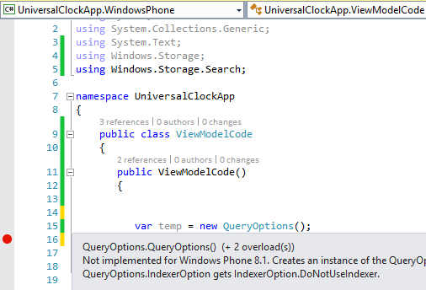
Another Thing to watch out for
#if WINDOWS_APP
var temp = new QueryOptions();
#endif
Notes:
Demo!
Be careful trusting intelisense. In store and phone apps there are cases where a class is valid for store but not phone and there is nothing in intelisense to warn you if phone is not supported.
Strongly agree here, it's confusing because you never know for sure when an API you use will blow up on either platform, unless you try it out (or read the docs, TBH). One of such examples is in Windows.Storage namespace:
KnownFolders.MediaServerDevices exists on both platforms, but using it in Windows Phone would blow up "unexpectedly".
On the other hand, ApplicationData.Current.LocalCacheFolder exists only on Windows Phone and you can't compile a Store project until you #ifdef it out.
Both APIs return a StorageFolder so it's not like they are completely different things. Hiding unsupported APIs would make this work much more transparently for developers...

Slide 8
Tools for Phone development
Windows phone Power tools - http://wptools.codeplex.com/
Iso Store Spy - https://isostorespy.codeplex.com/
Project My Screen App -http://www.microsoft.com/en-us/download/details.aspx?id=42536
Visual Studio Performance and Diagnostics
Windows Phone Developer Power Tools (8.1)

Slide 9
MVVM Libraries
MVVM Light
Prism
MvvmCross
Catel.MVVM
Caliburn.Micro
Notes:
MvvmCross supports Xamarin

Slide 10
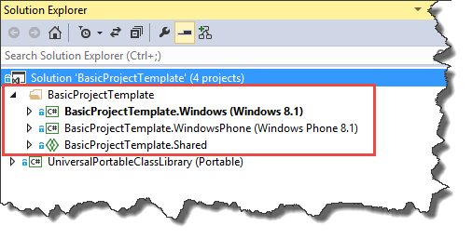
Anatomy of a Universal App

Slide 11
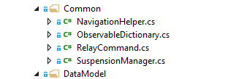
Helpers that come for free

Slide 18
PowerPoint Guidelines
Font, size, and color for text have been formatted for you in the Slide Master
Use the color palette shown below
See next slide for additional guidelines
Hyperlink color: www.microsoft.com
Sample Fill
Sample Fill
Sample Fill
Sample Fill
Sample Fill
Sample Fill

Slide 19
PowerPoint Template Subtitle color
Example of a slide with a subhead
Set the slide title in “title case”
Set subheads in “sentence case”
Generally set subhead to 36pt or smaller so it will fit on a single line
The subhead color is defined for this template but must be selected. In PowerPoint 2007, it is the fourth font color from the left

Slide 20
Bar Chart Example

Slide 21
Pie Chart Example

Slide 22
Line Chart Example

Slide 23
Area Chart Example

Slide 24
Demo Title
Name
Title
Group
demo

Slide 25
Video Title
video

Slide 26
Partner Title
Name
Title
Company
partner

Slide 27
Customer Title
Name
Title
Company
customer

Slide 28
Announcement Title
announcing

